Slide 1
THE NEUMAN SYSTEMS MODEL

Slide 2
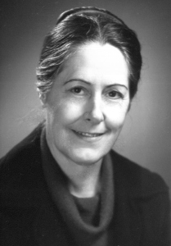
BETTY NEUMAN
Brief introduction
Born in 1924 in Ohio.
Diploma – 1947, from People’s hospital, Ohio
B.S. in public health nursing – 1957
M.S. as public health- mental health nurse consultant-1966, California
Honorary doctorates

Slide 3
INTRODUCTION CONTD…
Doctorate in clinical psychology from Pacific Western University- 1985
Honorary doctorate
Areas:
Public health, hospital, school health, industry and mental health settings.

Slide 4
DEVELOPMENT OF NEUMAN SYSTEMS MODEL
Model was originally developed in 1970 as a teaching aid ( A model for teaching total person approach to patient problems )
1st published in Nursing research – 1972
Neuman systems model as a title since – 1985
4 editions: (1982, 1989, 1995, Neuman and Fawcett, 2002)

Slide 5
MODEL

Slide 6
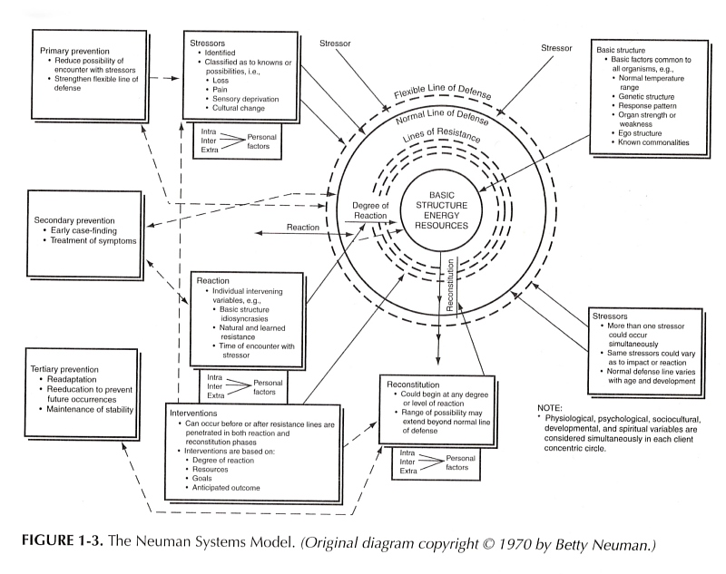

Slide 7
THE NEUMAN SYSTEMS MODEL
Provides a comprehensive, flexible, holistic and system based perspective for nursing.
Deals with stress and stress reduction and is primarily concerned with the effects of stress on health.
According to her, this model provides a total approach to client problems by providing a multidimensional view of the person as an individual.

Slide 8
Fig 1. Core and concentric circles
Flexible line of defense
Normal line of defense
Basic structure/ Core
Line of resistance
Notes:
Surrounding the basic core structure are concentric circles, which include: line of resistance and line of defense.

Slide 9
FLEXIBLE LINE OF DEFENSE
Outer boundary
Initial response or protective barrier to prevent stressors from breaking through the normal line of defense.
Cushion
Dynamic
As distance between FLOD and NLOD increases , so does the degree of protection.
Affected by variables such as loss of sleep, inadequate nutrition ;that reduce the client's ability to use a flexible line of defense against stressors.
Notes:
The particular inter-relationships of client variables at any point in time can affect the degree to which a client is protected by the flexible LOD. Stability, or homeostasis, occurs when the amount of energy that is available exceeds that being used
Any environmental force that alters the system's stability.
Intrapersonal stressors
Interpersonal stressors and
Extrapersonal stressors
Intrapersonal - occur within person, example is infection, fear and feelings
Interpersonal - occur between individuals, e.g. role expectations
Extrapersonal - occur outside the individual, e.g. job or finance pressure
Many known, unknown, and universal stressors exist. Each differ in it’s potential for disturbing a client’s usual stability level or normal LOD (Line of Defence)

Slide 10
NORMAL LINE
OF DEFENSE
Represents stability over time or normal wellness state.
Any stressors may invade the NLOD when FLOD offers inadequate protection.
When NLOD is invaded the client system reacts.
Reactions will be apparent in symptoms of instability or illness.
Notes:
If flexible line of defense cannot protect a person from stressor, it can break through normal line of defense causing a reaction which depends on the client's lines of resistance.
Amount of system instability that occurs after exposure to a stressor.
Determined by natural and learned resistance; manifested by strength of lines of resistance and of normal and flexible lines of defense.
Determined by timing, type, strength of stressor, person's core structure, experience and perception.
Person's system can adapt to the stressor : this adaptation is called reconstitution.

Slide 11
LINES OF RESISTANCE
Protects the basic structure.
Becomes activated when NLOD is invaded by environmental stressors.
For e.g.: activation of immune system mechanisms.
If LOR is effective , system can reconstitute.
If not effective, the resulting energy depletion may lead to death.
Notes:
The particular inter-relationships of client variables at any point in time can affect the degree to which a client is protected by the flexible LOD.

Slide 12

THE BASIC CORE STRUCTURE
Made up of the basic survival factors that are common to the species (Neuman,2002).
Includes: normal temperature range, genetic structure, response pattern, organ strength or weakness, ego structure.
Notes:
These factors include:- – Normal temp. range, Genetic structure.- Response pattern. Organ strength or weakness, Ego structure.

Slide 13
CLIENT VARIABLES
Each concentric circle or layer is made up of the five variable areas which occur simultaneously in each client :
Physiologic variables
Psychological variables
Socio-cultural variables
Developmental variables
Spiritual variables- added in 1989
Notes:
Each concentric circle or layer is made up of the five variable areas which are considered and occur simultaneously in each client concentric circles

Slide 14
CLIENT VARIABLES contd…
In ideal situation these variables function in harmony.
Each of the variables should be considered when assessing system reactions to stressors for each of the concentric circles in the model diagram.

Slide 15
NURSING INTERVENTIONS
Focus on retaining or maintaining system stability.
Are carried out on three preventive levels.
Primary prevention as intervention
Secondary prevention as intervention
Tertiary prevention as intervention

Slide 16
METAPARADIGM
Human being
Is viewed as an open system that interacts with both internal and external environmental forces and
stressors.
The human is in constant change, moving towards a dynamic state of system stability or towards illness of varying degrees.

Slide 17
ENVIRONMENT
The environment may be viewed as all factors that affect and affected by the system. It includes interpersonal, intrapersonal and extra-personal stressors that interfere with person's normal line of defense and can affect the system's stability.

Slide 18
HEALTH
Defined as condition or degree of system stability
and is viewed as a continuum from wellness to illness.
Stability occurs when all system's parts and subparts are in balance or harmony so that the
whole system is in balance.

Slide 19

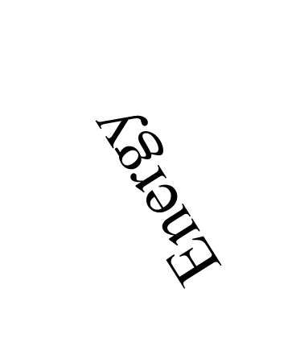
WELLNESS ILLNESS CONTINUM
Wellness : More energy available and stored than expended
Towards increasing wellness
Interventions
(Disrupting forces or stressors)
Towards increasing illness
Death: More energy needed than is available to support life

Slide 20
NURSING
As actions that assist persons, families and groups to attain and maintain a maximum level of wellness.
Nursing uses primary, secondary and tertiary interventions to reduce client's stressors. It consist of three steps : Nursing diagnosis, nursing goals and nursing outcomes.

Slide 21
APPLICATION OF NEUMAN SYSTEM MODEL IN CLINICAL PRACTICE

Slide 22
Neuman System Model Nursing Process Format
Neuman presents a 3 step nursing process format, known as the Neuman System Model Nursing Process Format.
  Nursing Diagnosis (assessment and diagnosis)
  Nursing Goals (plan and expected outcomes)
  Nursing Outcomes (implementation and evaluation)
Notes:
The purpose is clinical practice is to assist clients to retain, attain and maintain optimal client stability.

Slide 23
Nursing Diagnosis
To identify variances from wellness and development of hypothetical interventions
Nurses focus on obtaining data of client with regards:
  To determine the existing state of wellness
    (Assessment of basic structure, FLOD,NLOD,LOR)
  Identify, classify and evaluate actual and potential stressors
    ( intra, inter and extra personal interaction in all five variables)
  Identify, classify and evaluate the actual or potential reaction to environmental stressors.
  Evaluate the influence of past, present and future coping patterns.
For this use assessment and intervention tool.
Notes:
Assessment of basic structure, FLOD,NLOD,LOR, degree of potential reaction
Includes the use of database to identify variances from wellness and development of hypothetical interventions.
Assessment and intervention tool is used.

Slide 24
An assessment and intervention tool
1. Intake summary
Name, Age, Sex, Marital Status, referral source and related information
2. Stressors as perceived by clients
  Major stress area of health concerns
  lifestyle patterns
  past coping patterns
  anticipating oneself in the future as a consequences of present situation
  activities doing to help oneself now and what can you do
  and expectation of activities for oneself from caregivers, family, friends
Notes:
7steps: If client cant get data from family memebers; {perceptual experience - the representation of what is perceived; basic component in the formation of a conceptperceptual factors (expectations, present and possible future coping patterns)},

Slide 25
Contd..
3. Stressors as perceived by caregiver
  Major stress area of health for client
  difference of client present and usual pattern of living
  client past coping patterns
  anticipating client in the future as a consequences of present situation
  activities of client to help himself
  and expectation of client (activities) from caregivers, family, friends
Summary of impression
Note any discrepancies or distortion between the client’s perception and that of the caregiver as relates to the situation.

Slide 26
Contd..
4. Intrapersonal factors
  Physical
  Psychological
  Sociocultural
  Developmental
  Spiritual
5. Interpersonal factors- resources and relationships of family, friends or caregivers that either influence or could influence area 4.
6. Extrapersonal factors - resources and relationships of community facilities, finances, employment or other area that either influence or could influence area 4 and 5.
Overall summary
  Physiological, Pshyological, Sociocultural, Developmental and Spiritual

Slide 27
Contd…
7. Formulation of a comprehensive Nursing Diagnosis
Identifying and ranking the priority of needs based on total data obtained from :
  the client’s perception
  the caregivers perception
  or other resources such as laboratory reports, other caregivers or agencies.

Slide 28
Nursing Goal
Intervention strategies negotiated with client to retain, attain and maintain client/client system stability.
Outcomes are specified under it as goal outcome to correct variances.
Notes:
Based on the identified needs and the available resources.
Outcomes are specified under nursing goals in the NSM as goal outcomes to correct variances.

Slide 29
Nursing outcomes
Begin with nursing intervention i.e. 3 levels of prevention-as-intervention and that may be using one or more.
Theses nursing interventions-as-prevention are followed by evaluation to confirm that the anticipated or prescribed change has occurred.
  If this is not true, then goals are reformulated.
long-range goals are then structured in relation to the short-range outcomes.
Output validates nursing process and acts as feedback to further system input as required.
Notes:
Identify the mode of nursing action

Slide 30
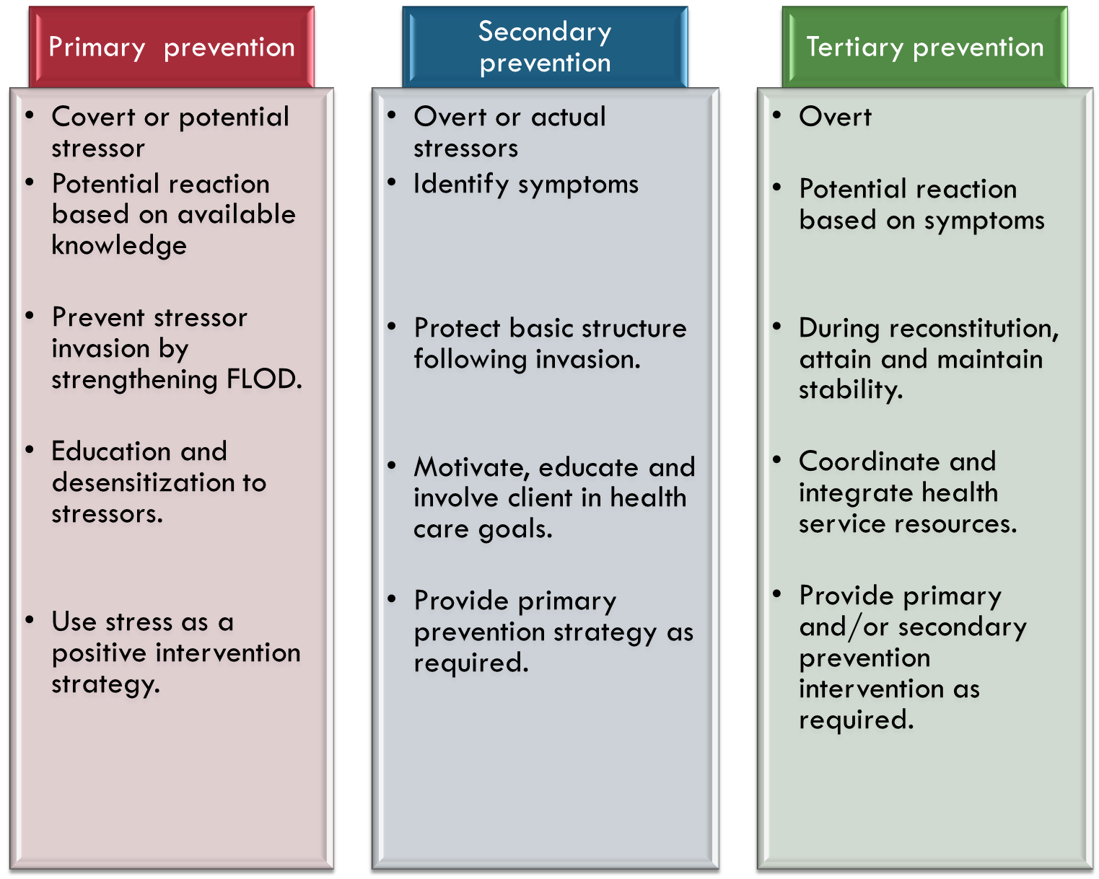
Notes:
Flod—desensitize existing or possible noxious stressors.

Slide 31

Hypothetical Situation
  3 months Pregnant mother with 13 months old daughter
  Nausea
  Wants another child ambivalent about the timing of this pregnancy
Notes:
and fatigue

Slide 32
Contd…
Using Neuman System Model Nursing Process Format:
  Nursing Diagnosis
  Nursing Goals
  Nursing Outcomes

Slide 33
Nursing diagnosis
Assessment and intervention tool
Intake summary
Name:-
Age:-
Sex:-
Marital Status:-
Referral source :-
Notes:
Self-refferal

Slide 34
Contd…
2. Stressor as perceived by client
Major stress area or area of concern:
  Nausea
  Worried about caring the 2 children under 2years.
Lifestyle patterns
  Home maker and care her 13 months old daughter (and 55 years mother-in-law and husband)
  Participates in community group
  Go temple usually
  Has supportive family and friends
  What is different now?—experiencing nausea and so change in eating pattern

Slide 35
Contd…
Ever experienced similar problem?
  Nausea and vomiting are similar to first pregnancy
  What helped then- biscuits help some
Anticipation for the future
  Concerns about how to maintain a healthy pregnancy and care of the toddler
  Also anticipating the demands of caring for 2 children under the age of two
Notes:
and lying down help some

Slide 36
Contd…
What is client doing to help herself?
  Taking dry foods
  Talking with friends and family (mother-in-law) about their experience
  Reading article, books and watching TV on childbearing and childrearing
What is expected of others?
  Mother-in-law will take care of the toddler
  Family will be around the time of the baby delivery and will help with the children and the house
  Family will ask her to stay for around 2-3 months after nawaran and Mother-in-law is taking care of the toddler
  Husband will do more cooking and help in household matters

Slide 37
Contd…
3. Stressor as perceived by caregiver
Major stress area
  Nausea
Present circumstances differing from usual pattern from living
  Nausea and fatigue of pregnancy
  Dealing with anticipation concerning regarding expanding family

Slide 38
Contd…
Client’s past experience with similar situation
  Experienced with nausea and fatigue of pregnancy
Future anticipation
  Client is capable of handling the situation—will need support and encouragement to do so
Notes:
Not experienced in having 2 children under 2 age

Slide 39
Contd…
What can client do to help herself?
  Take dry foods, small frequent feeds, avoid fatty foods
  Use her support systems
  Concentrate on getting rest
  Have positive thinking about having healthy baby
Clients expectations of family, friends and caregivers
  Accurate information
  Support and encouragement
Summary of impressions: no apparent discrepancies between perception of client and caregivers

Slide 40
Contd…
3. Intrapersonal factors
  Physical
    Height:
    Weight:
    TPR:
    Blood pressure:
    Care- perform all activities of daily living
    Sleeps
    Does not smoke of ingest alcohol
    Follow balance diet
    Now--- nausea and fatigue and so decreased intake of foods--- stressor at this time

Slide 41
Contd…
Psycho-social cultural
  -- years, married
  Hindu
  Complete I.ED.
  Don’t have high expectation but is workaholic
  Lives in own home
  Knows Nepali and English

Slide 42
Contd…
Developmental
  “I have demonstrated my ability to be a good mother- that is reassuring that I can meet this new challenge”
  “how am I going to find the time to do everything?”
Spiritual belief
  Usually go to near temple
  Involve in religious activities
  Have a small temple in her own home where she worship daily
Notes:
Read Geeta to her mother-in-law

Slide 43
Contd…
4. Interpersonal factors
  active in the household work. (physical)
  has supportive family and friends
  Often visit her father’s home.
  Play with toddler but now she often get tired , her mother-in-law often helps her.
  Good interpersonal relationship with husband and mother-in-law. (developmental)
  active in the religious activities. (spiritual)

Slide 44
Contd…
5. Extrapersonal factors
  Good social support system is present.
  All the health care facilities are present at her place.
  All communication facilities, travel and transport facilities etc are present at her own place.
  Financially she is stable.
  In her community there is also the facilities of day care centre for toddlers.
  Good social interaction with others.
  Member of ama samuha. (developmental)
  Participate in puja (lakbatti) organize by neighbor, relatives. (spiritual)

Slide 45
Contd…
Summary
Physiological:- normal pregnancy with associated stressors of nausea.
Psychosociocultural factors:- Has supportive family and friends.
Developmental:–Appropriate to the age.
Spiritual:- Belief system is a positive support.
Notes:
Worried about caring two child under 2 age.

Slide 46
Contd…
1. Nursing diagnosis
  Nausea and fatigue related to pregnancy
  Lack of knowledge related to parenting two children under the age of two
2. Nursing Goal
  Manage nausea and fatigue so can continue normal activities of daily living.
  Plan strategies for coping with two children under the age of two.

Slide 47
Contd…
3. Nursing Outcomes (Prevention-as- Intervention)
Manage nausea and fatigue
  Primary:- Normal line of defense has been invaded
  Secondary:- explore types of foods and eating patterns that decrease nausea ;plan daily activities to include rest period when toddler naps; mother-in-law take care of toddler mostly
  Tertiary:- continue to encourage rest whenever possible; husbands helps out as he can; plan daily intake of appropriate nutrients

Slide 48
Contd…
b. Having the knowledge about parenting two children
  Primary :- discuss current parenting strategies with husband, mother-in-law, family, friends, caregiver and explore how these strategies may be adapted; caregiver encourages discussion with friend who has two small children and works full time.
  Secondary and tertiary: not needed as yet; flexible and normal lines of defense have functioned effectively.

Slide 49
Contd…
Evaluation of goals
  Evaluate whether nausea and fatigue are reduced or not.
  Evaluate whether client has acquired necessary information about parenting strategies or not
  If not met, then goals are reformulated.

Slide 50
STRENGTHS
AND
LIMITATIONS

Slide 51
STRENGTHS
The relationship among concepts are logically and clearly defined.
Fairly simple and straightforward in approach.
Easily identifiable definitions
The holistic system approach used; indicates the model is not situation specific but may be used in a variety of situations.
Notes:
Ainterrelated concepts
logically consistent.
Relevant with present context of holistic patient care.
lthough the model is a conceptual framework for nursing, Although concepts are organized in a complex manner,

Slide 52
STRENGTHS contd..
Provides clear direction for interventions through primary, secondary, and tertiary prevention which have gained universal acceptance.
Although the model is a conceptual framework for nursing, its comprehensive and flexible nature make it adaptable for future use regarding health care issues of the twenty first century and can be used in a variety of clinical and educational settings

Slide 53
STRENGTHS contd….
Model is generally congruent with current societal expectation of nursing care.
Has increased focus on promotive and preventive aspects along with curative aspects.
Notes:
Moreoand concerns facing nursing and health care delivery in twenty first century.ver, this intervention modalities have gained universal acceptance

Slide 54
STRENGTHS contd….
It stressed mutual determination of client intervention goals. These characteristics follow current mandates within the health care system for client rights in health care issues.
Provide important guidelines for nursing research, education and practice.
Notes:
In the Neuman nursing process format , both client and caregiver perception are determined for relevant goal setting. The clear and detail assessment process fully explains the clients condition, providing the logic or rational for subsequent nursing action. Furthermore, these aspects of the conceptual model indicate her respect for the perception and right of each client. both client and caregiver perception are determined for relevant goal setting. The clear and detail assessment process fully explains the clients condition, providing the logic or rational for subsequent nursing action. Furthermore, these aspects of the conceptual model indicate her respect for the prerception and right of each client.

Slide 55
LIMITATIONS
Some concepts like level of wellness, and concept of reconstitution requires clearer definition and further explanations.
Although reaction is identified in the pictorial model, it is not discussed separately.
The pictorial model is rather overwhelming on first view.

Slide 56
LIMITATIONS contd…
Components of the flexible line of defense interact in very complex ways and it may be difficult to overgeneralize their interaction.
While it is useful to think of people as layered and made up of five principles, it is not always easy to predict or describe their interplay.
Notes:
Moreover, since each layer is composed of all the person variables, it is not always clear as to what layer is being assessed in any operationalized variable. Because human beings are very complex and are driven by their values and beliefs regarding certain situations, one must question the ability to predict someone’s interaction with the environment.
Because human beings are very complex and are driven by their values and beliefs regarding certain situations, one must question the ability to predict someone’s interaction with the environment. Since each layer is composed of all the person variables, it is not always easy to define what layer is being assessed in any operational variable (Tomey & Alligood, 2006).

Slide 57
LIMITATIONS contd….
Lacks clear definition, especially the differences between stressors (interpersonal and extrapersonal).
Neuman Systems Model is not a theory by definition, but a concept.

Slide 58
THANK YOU

